Slide 1
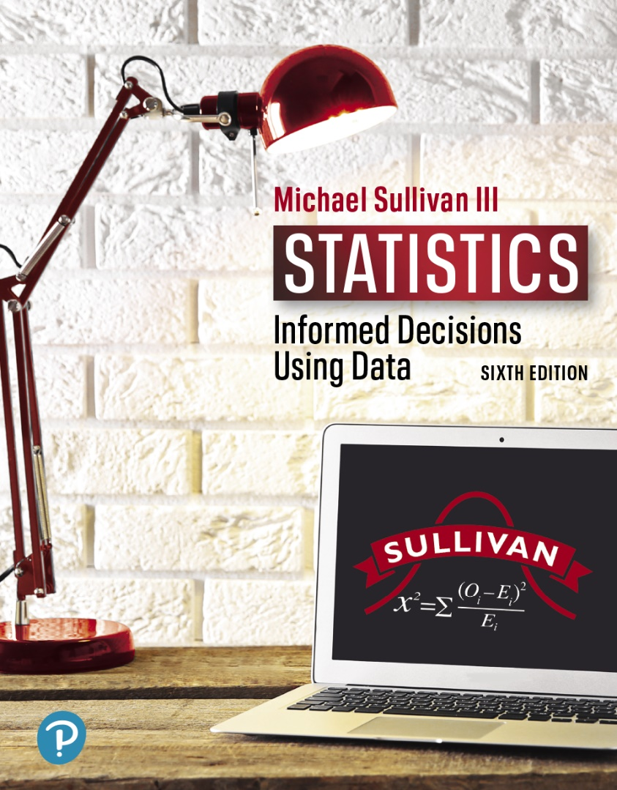
STATISTICS
INFORMED DECISIONS USING DATA
Chapter 12
Inference on Categorical Data
12-1

Slide 2

12.1 Goodness-of-Fit Test
Learning Objectives
Perform a goodness-of-fit test
12-2

Slide 3
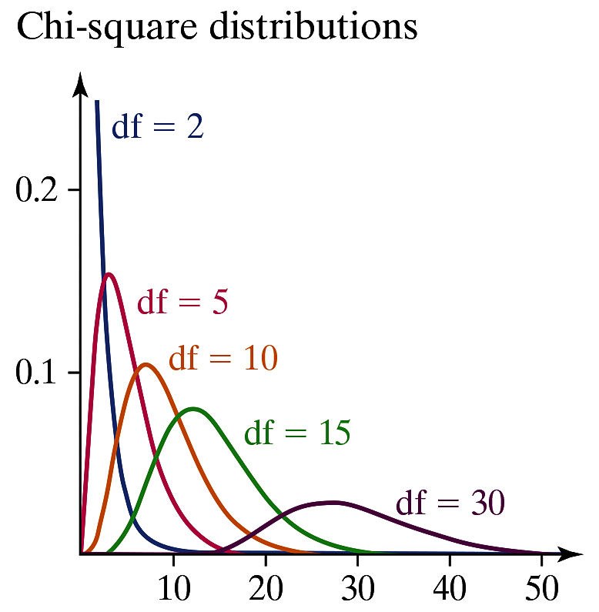
Characteristics of the Chi-Square Distribution
1. It is not symmetric.
2. Its shape depends on the degrees of freedom, just
like Student’s t-distribution.
3. As the number of degrees of
freedom increases, it becomes
more symmetric, as illustrated
in the figure.
4. The values of χ² are
nonnegative. That is, the
values of χ² are greater than
or equal to 0.
12-3

Slide 4
A goodness-of-fit test is an inferential procedure used to determine whether a frequency distribution follows a specific distribution.
12-4

Slide 5


Expected Counts
Suppose that there are n independent trials of an
experiment with mutually exclusive possible
outcomes. Let p₁ represent the probability of observing
the first outcome and E₁ represent the expected count of
the first outcome; p₂ represent the probability of
observing the second outcome and E₂ represent the
expected count of the second outcome; and so on. The
expected counts for each possible outcome are given by
for i = 1, 2, …, k
12-5

Slide 6
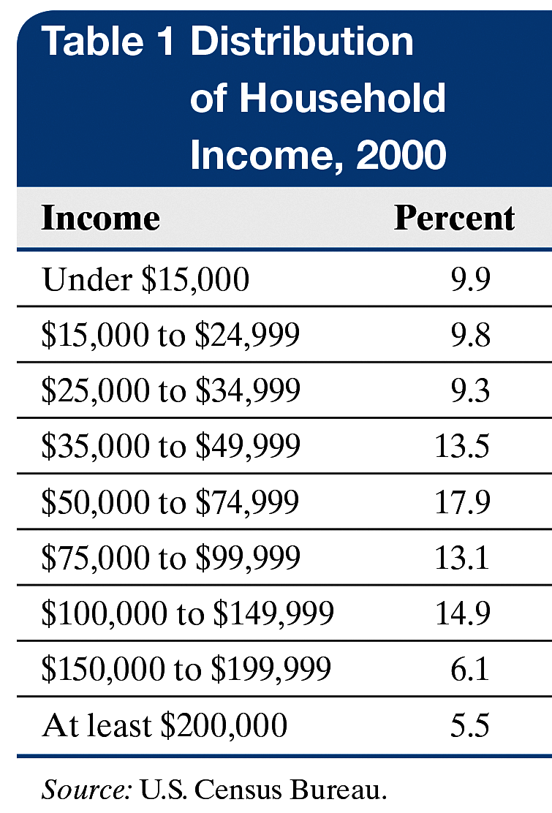
EXAMPLE Finding Expected Counts
(1 of 4)
One growing concern regarding the
U.S. economy is the inequality in the
distribution of income. The data in
Table 1 represent the distribution of
household income for various levels of
income in 2000. An economist wants
to know if the distribution of income is
changing, so she randomly selects
1500 households and obtains the
household income. Find the expected
number of households at each income
level assuming that the distribution of
income has not changed since 2000.
12-6

Slide 7
EXAMPLE Finding Expected Counts
(2 of 4)
Step 1 The probabilities are the relative frequencies from the 2000 distribution:
p_{under 15,000} = 0.099 p_{15,000 – 24,999} = 0.098
p_{25,000 – 34,999} = 0.093 p_{35,000 – 49,999} = 0.135
p_{50,000 – 74,999} = 0.179 p_{75,000 – 99,999} = 0.131
p_{100,000 – 149,999} = 0.149 p_{150,000 – 199,999} = 0.061
p_{At least 200,000} = 0.055
12-7

Slide 8
EXAMPLE Finding Expected Counts
(3 of 4)
Step 2 The expected counts for each income are as follows:
Expected count of under $15,000:
np_{under 15,000} = 1500(0.099) = 148.5
Expected count of $15,000 to $24,999:
np_{15,000 to 24,999} = 1500(0.098) = 147
Expected count of $25,000 to $34,999:
np_{25,000 to 34,999} = 1500(0.093) = 139.5
Expected count of $35,000 to $49,999:
np_{35,000 to 49,999} = 1500(0.135) = 202.5
Expected count of $50,000 to $74,999:
np_{50,000 to 74,999} = 1500(0.179) = 268.5
Expected count of $75,000 to $99,999:
np_{75,000 to 99,999} = 1500(0.131) = 196.5
12-8

Slide 9
EXAMPLE Finding Expected Counts
(4 of 4)
Expected count of $100,000 to $149, 999:
np_{100,000 to 149,999} = 1500(0.149) = 223.5
Expected count of $150,000 to $199,999:
np_{150,000 to 199,999} = 1500(0.061) = 91.5
Expected count of at least $200,000:
np_{At least 200,000} = 1500(0.055) = 82.5
Of the 1500 households surveyed, the economist expects to have 148.5 households that earned under $15,000, 147 that earned $15,000 to $24,999, and so on, assuming the distribution of income has not changed since 2000.
12-9

Slide 10
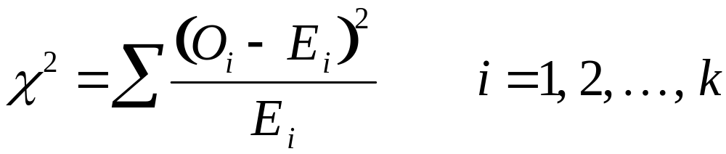
Test Statistic for Goodness-of-Fit Tests
Let O_{i} represent the observed counts of category i, E_{i}
represent the expected counts of category i, k represent
the number of categories, and n represent the number of
independent trials of an experiment. Then
approximately follows the chi-square distribution with
k – 1 degrees of freedom, provided that
all expected frequencies are greater than or equal to 1
(all E_{i} ≥ 1) and
no more than 20% of the expected frequencies are
less than 5.
Note: E_{i} = np_{i} for i = 1, 2, … , k
12-10

Slide 11
CAUTION!
Goodness-of-fit tests are used to test hypotheses regarding the distribution of a variable based on a single population. If you wish to compare two or more populations, you must use the tests for homogeneity presented in another section.
12-11

Slide 12
The Goodness-of-Fit Test
To test the hypotheses regarding a distribution,
we use the steps that follow.
Step 1 Determine the null and alternative hypotheses:
H₀: The random variable follows a certain
distribution.
H₁: The random variable does not follow
the distribution in the null hypothesis.
Step 2 Decide on a level of significance, α, depending on the seriousness of making a Type I error.
12-12

Slide 13

  The Goodness-of-Fit Test
  Step 3
  (a) Calculate the expected counts, E_{i} , for each of the
  k categories. The expected counts are E_{i} = np_{i} for
  i = 1, 2, … , k where n is the number of trials and
  p_{i} is the probability of the ith category, assuming
  that the null hypothesis is true.
(b) Verify that the requirements for the goodness-of-
fit test are satisfied.
1. All expected counts are greater than or equal
to 1 (all
2. No more than 20% of the expected counts
are less than 5.
12-13

Slide 14
CAUTION!
If the requirements in Step 3(b) are not satisfied, one option is to combine two or more of the low-frequency categories into a single category.
12-14

Slide 15
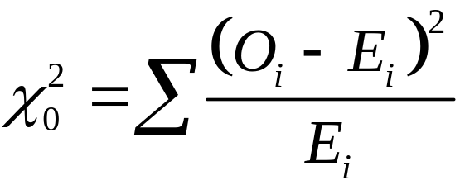
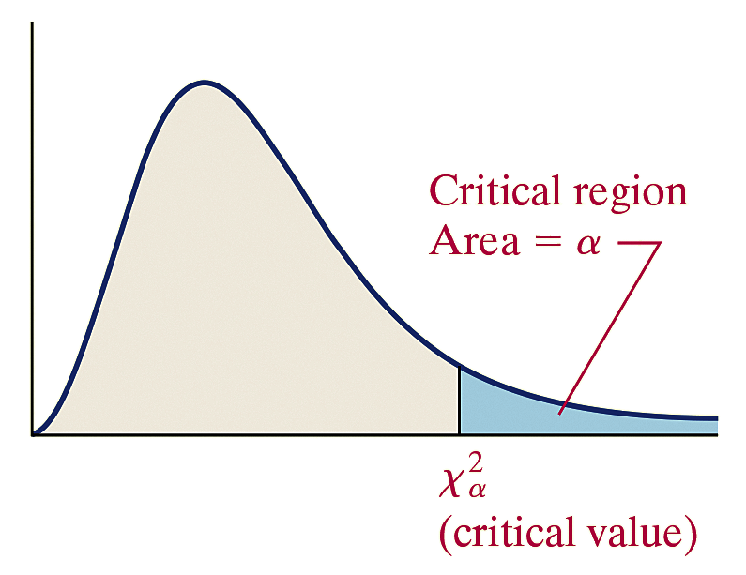

The Goodness-of-Fit Test
Classical Approach
Step 3 (continued)
(c) Compute the test statistic
Note: O_{i} is the observed count for the ith category.
Step 4 Determine the critical
value using Table VIII. All
goodness-of-fit tests are right-
tailed tests, so the critical value
is with k – 1 degrees of
freedom.
12-15

Slide 16

The Goodness-of-Fit Test
Classical Approach
Compare the critical value to the statistic. If reject the null hypothesis.
Step 5 State the conclusion.
12-16

Slide 17
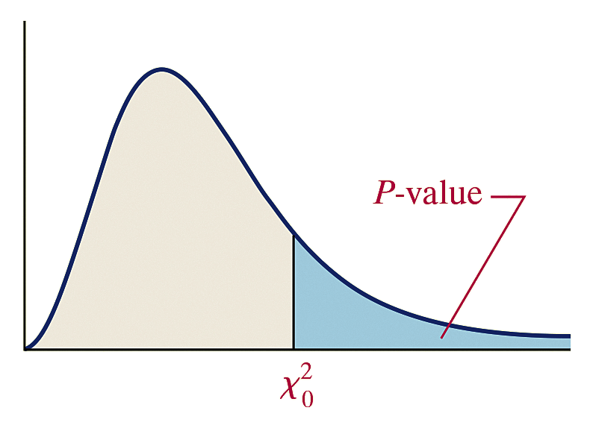
The Goodness-of-Fit Test
P-Value Approach
By hand Step 3 (continued)
(c) Compute the test statistic
Note: O_{i} is the observed count for the ith category.
(d) Use Table VIII to
approximate the P-value by
determining the area under the
chi-square distribution with
k – 1 degrees of freedom to
the right of the test statistic.
12-17

Slide 18
The Goodness-of-Fit Test
P-Value Approach
Technology Step 3 (continued)
(c) Use a statistical spreadsheet or calculator with
statistical capabilities to obtain the P-value.
Step 4 If P-value < α, reject the null hypothesis.
Step 5 State the conclusion.
12-18

Slide 19
EXAMPLE Conducting a Goodness-of-Fit Test
(1 of 11)
One growing concern regarding the U.S. economy is the inequality in the distribution of income. An economist wants to know if the distribution of income is changing, so she randomly selects 1500 households and obtains the household income shown in Table 2, which is shown on the next slide. Table 2 also contains the expected counts under the assumption the distribution has not changed since 2000 (obtained in a previous example). Does the evidence suggest that the distribution of income has changed since 2000 at the α = 0.05 level of significance?
Note: The data in Table 2 is based on the 2017 Current Population Survey and has been adjusted for inflation.
12-19

Slide 20
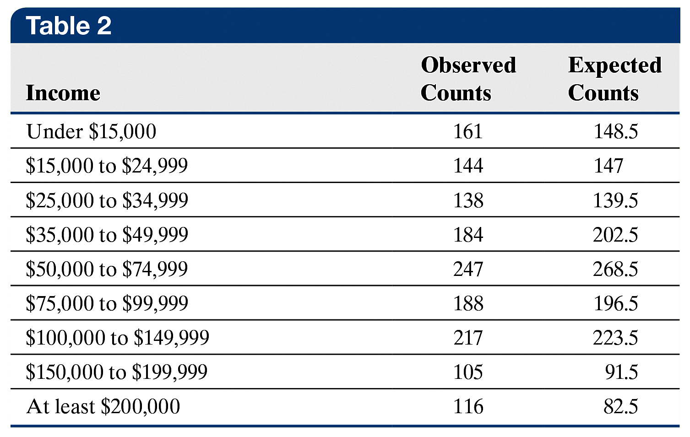
EXAMPLE Conducting a Goodness-of-Fit Test
(2 of 11)
12-20

Slide 21
EXAMPLE Conducting a Goodness-of-Fit Test
(3 of 11)
Step 1 The null hypothesis is always a statement of “no difference.” Here, that means there is no difference in the distribution of income between 2000 and today. We are looking for the sample evidence (sample data) to show that the distribution is different today.
H₀: The distribution of household income in the United States
is the same today as it was in 2000.
H₁: The distribution of household income in the United States
is different today from what it was in 2000.
12-21

Slide 22
EXAMPLE Conducting a Goodness-of-Fit Test
(4 of 11)
Step 2 The level of significance is α = 0.05.
Step 3
(a) We computed the expected counts in a previous example.
The observed and expected counts are in Table 2.
(b) Since all expected counts are greater than or equal to 5, the
requirements for the goodness-of-fit test are satisfied.
12-22

Slide 23
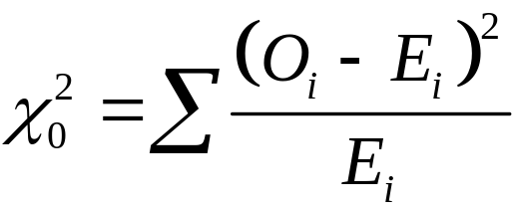
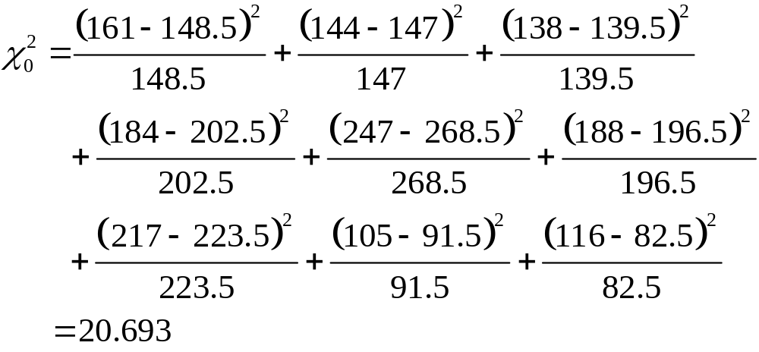
EXAMPLE Conducting a Goodness-of-Fit Test
(5 of 11)
Classical Approach
Step 3 (continued)
(c) The test statistic is
12-23

Slide 24

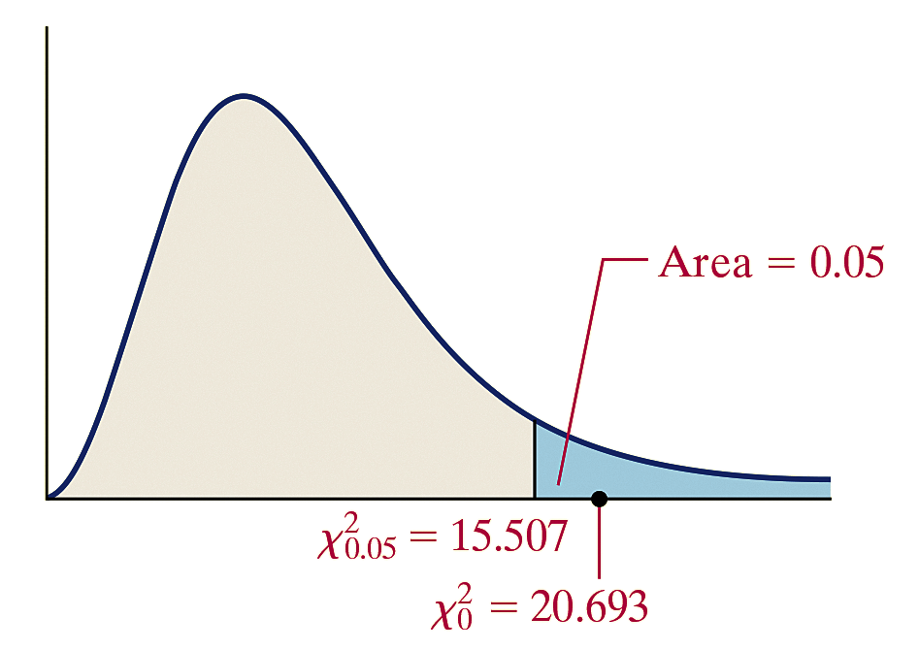
EXAMPLE Conducting a Goodness-of-Fit Test
(6 of 11)
Classical Approach
Step 4 There are k = 9 categories, so we find the critical value using 9 – 1 = 8 degrees of freedom. The critical value is
Because the test statistic, 20.693, is greater than the critical value, 15.507, we reject the null hypothesis.
12-24

Slide 25
EXAMPLE Conducting a Goodness-of-Fit Test
(7 of 11)
Classical Approach
Step 5 The sample evidence suggests there is sufficient evidence at the α = 0.05 level of significance to conclude the distribution of income in the United States is different today than it was in 2000.
12-25

Slide 26
EXAMPLE Conducting a Goodness-of-Fit Test
(8 of 11)
P-Value Approach
By Hand Step 3 (continued)
(c) The test statistic is
12-26

Slide 27
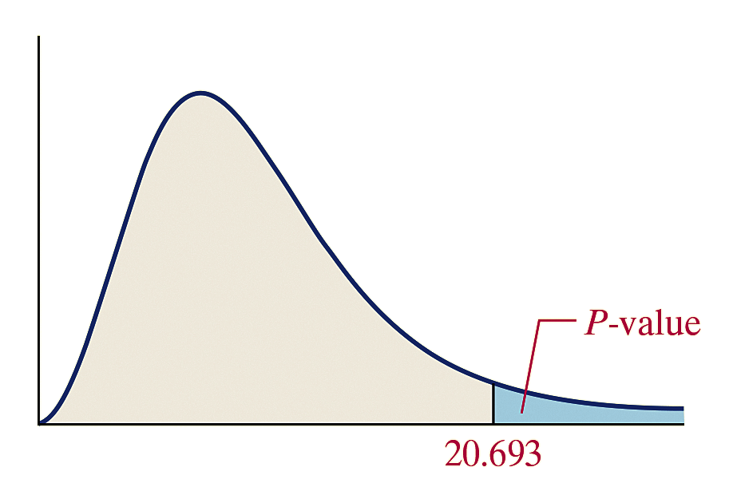

EXAMPLE Conducting a Goodness-of-Fit Test
(9 of 11)
P-Value Approach
(d) There are k = 9 categories.
The P-value is the area under
the chi-square distribution with
9 – 1 = 8 degrees of freedom to
the right of
Using Table VIII, find the row that corresponds to 8 degrees of freedom. The value of 20.693 lies between 20.090, which corresponds to an area to the right of 0.01, and 21.955, which corresponds to an area to the right of 0.005. Therefore, the P-value is between 0.005 and 0.01.
So, 0.005 < P-value < 0.01.
12-27

Slide 28
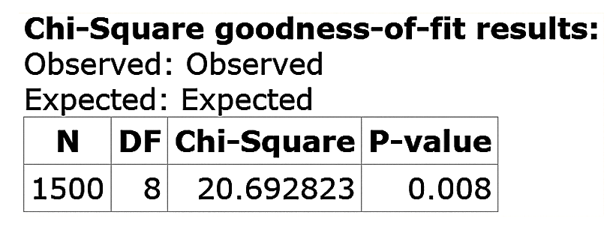
EXAMPLE Conducting a Goodness-of-Fit Test
(10 of 11)
P-Value Approach
Technology Step 3 (continued)
(c) The figure shows the result of the Goodness-of-Fit test
from StatCrunch. The P-value is reported as 0.008.
Step 4 The P-value of 0.008 means that if the null hypothesis “the distribution of income is the same today as in 2000” is true, we would expect about 8 samples in 1000 to yield the results at least as extreme as those we obtained.
12-28

Slide 29
EXAMPLE Conducting a Goodness-of-Fit Test
(11 of 11)
P-Value Approach
The observed results are unusual under the assumption the null hypothesis is true. Because the P-value is less than the level of significance (Tech: 0.008 < 0.05), we reject the null hypothesis.
Step 5 The sample evidence suggests there is sufficient evidence at the α = 0.05 level of significance to conclude the distribution of income in the United States is different today than it was in 2000.
12-29

Slide 30
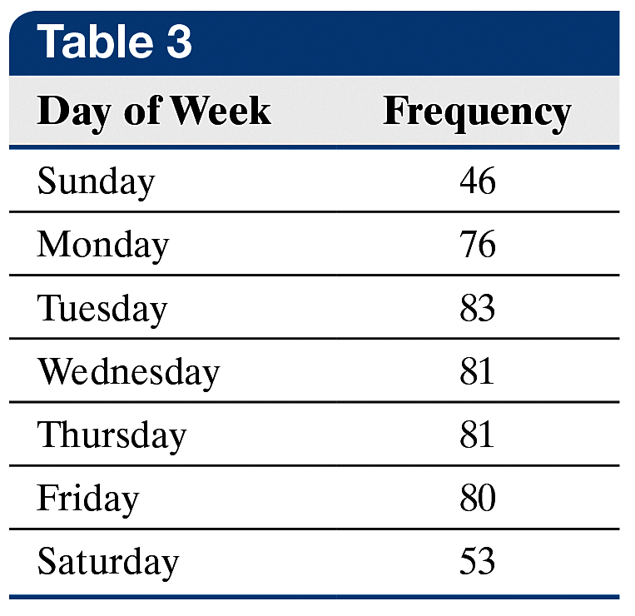
EXAMPLE Conducting a Goodness-of-Fit Test
(1 of 8)
An obstetrician wants to know
whether the proportion of children
born on each day of the week is
the same. She randomly selects
500 birth records and obtains the
data shown in Table 3 (based on
data obtained from Vital Statistics
of the United States, 2016).
Is there reason to believe that the day on which a child is born does not occur with equal frequency at the α = 0.01 level of significance?
12-30

Slide 31

EXAMPLE Conducting a Goodness-of-Fit Test
(2 of 8)
Step 1 The null hypothesis is a statement of “no difference,” so we assume that the day on which a child is born occurs with equal frequency. If 1 represents Sunday, 2 represents Monday, and so on, we have
H₀: p₁ = p₂ = p₃ = p₄ = p₅ = p₆ = p₇ =
H₁: At least one of the proportions is different from the
others.
Step 2 The level of significance is α = 0.01.
12-31

Slide 32
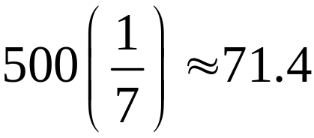
EXAMPLE Conducting a Goodness-of-Fit Test
(3 of 8)
Step 3
(a) The expected count for each category (day of the week),
assuming the null hypothesis is true, is
(b) Since all expected counts are greater than or equal to 5, the
requirements for the goodness-of-fit test are satisfied.
12-32

Slide 33
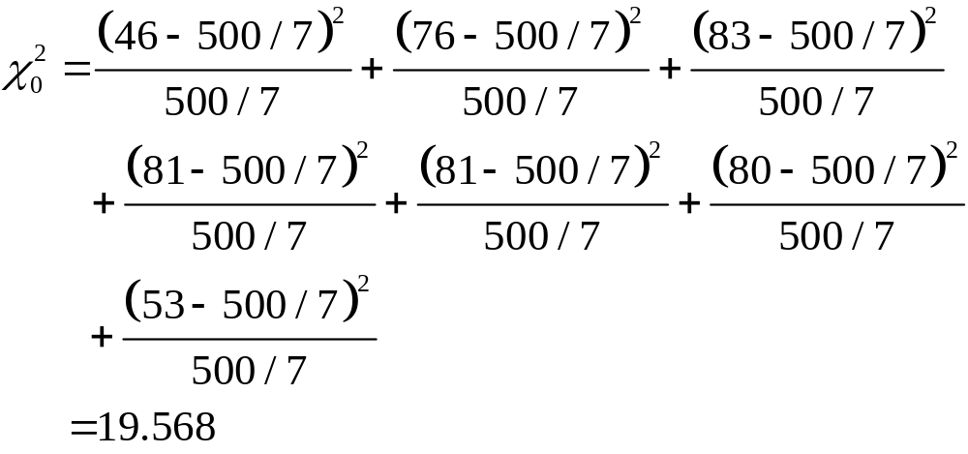
EXAMPLE Conducting a Goodness-of-Fit Test
(4 of 8)
(c) The test statistic is
12-33

Slide 34

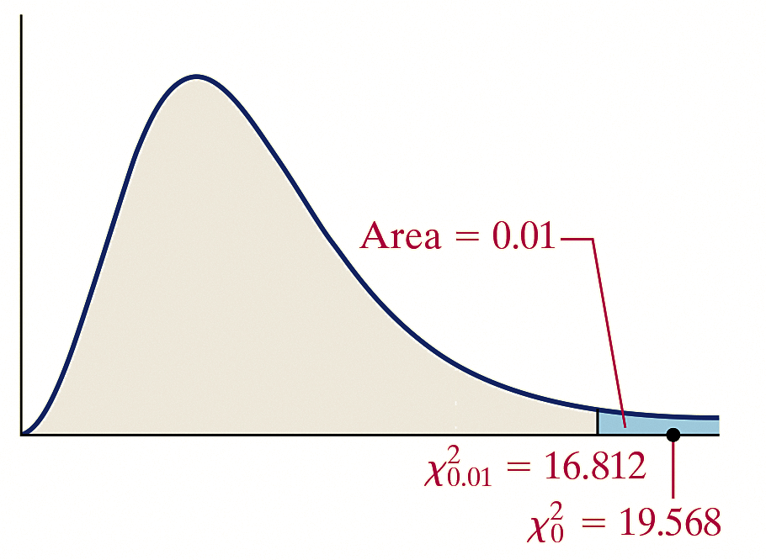
EXAMPLE Conducting a Goodness-of-Fit Test
(5 of 8)
Classical Approach
Step 4 There are k = 7 categories, so we find the critical value using 7 – 1 = 6 degrees of freedom. The critical value is
Because the test statistic, 19.568, is greater than the critical value, 16.812, we reject the null hypothesis.
12-34

Slide 35
EXAMPLE Conducting a Goodness-of-Fit Test
(6 of 8)
Classical Approach
Step 5 There is sufficient evidence at the α = 0.01 level of significance to reject the belief that the day of the week on which a child is born occurs with equal frequency.
12-35

Slide 36
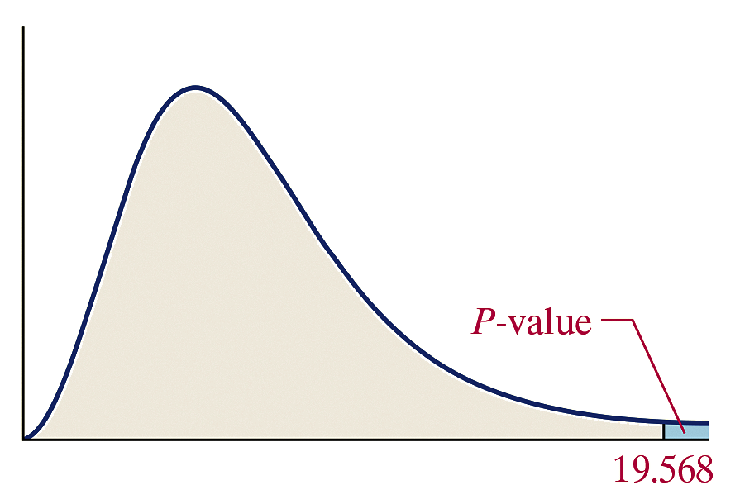

EXAMPLE Conducting a Goodness-of-Fit Test
(7 of 8)
P-Value Approach
Step 3 (continued) There are
k = 7 categories. The P-value is
the area under the chi-square
distribution with 7 – 1 = 6
degrees of freedom to the right
of
Using Table VIII, we find the row that corresponds to 6 degrees of freedom. The value of 19.568 is greater than 18.548, which has an area under the chi-square distribution of 0.005 to the right, so the P-value is less than 0.005 (P-value < 0.005). Using technology, the exact P-value is 0.0033.
12-36

Slide 37
EXAMPLE Conducting a Goodness-of-Fit Test
(8 of 8)
P-Value Approach
Step 4 Because the P-value is less than the level of significance, α = 0.01, we reject the null hypothesis.
Step 5 There is sufficient evidence at the α = 0.01 level of significance to reject the belief that the day of the week on which a child is born occurs with equal frequency.
12-37

Slide 38
12.2 Tests for Independence and
the Homogeneity of
Proportions
Learning Objectives
Perform a test for independence
Perform a test for homogeneity of proportions
12-38

Slide 39
Objective 1
Perform a Test for Independence
12-39

Slide 40
The chi-square test for independence is used to determine whether there is an association between a row variable and column variable in a contingency table constructed from sample data.
The null hypothesis is that the variables are not associated, or independent.
The alternative hypothesis is that the variables are associated, or dependent.
12-40

Slide 41
In a chi-square independence test, the null
hypothesis is always
H₀: The variables are independent
The alternative hypothesis is always
H₁: The variables are not independent
12-41

Slide 42
The idea behind testing these types of claims is to compare actual counts to the counts we would expect if the null hypothesis were true (if the variables are independent). If a significant difference between the actual counts and expected counts exists, we would take this as evidence against the null hypothesis.
12-42

Slide 43

To obtain the expected counts, compute the number of observations expected within each cell under the assumption of independence (the statement in the null hypothesis is true).
If two events are independent, then
We can use the Multiplication Principle for Independent Events to obtain the expected proportion of observations within each cell under the assumption of independence and multiply this result by n, the sample size, in order to obtain the expected count within each cell.
12-43

Slide 44
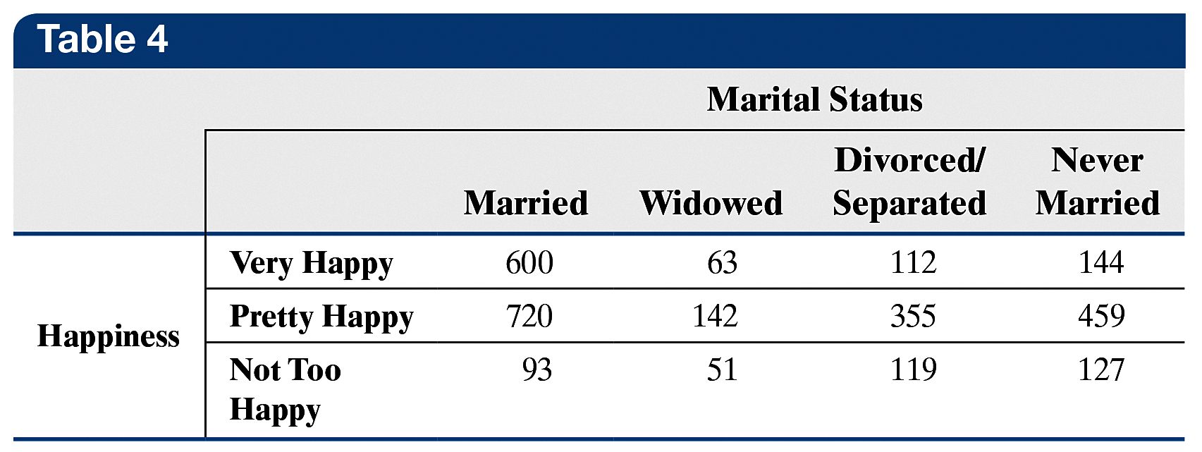
EXAMPLE Determining the Expected Counts in a
(1 of 6) Test for Independence
Is there a relationship between marital status and happiness? The data in Table 4 show the marital status and happiness of individuals who participated in the General Social Survey. Compute the expected counts within each cell, assuming that marital status and happiness are independent.
12-44

Slide 45
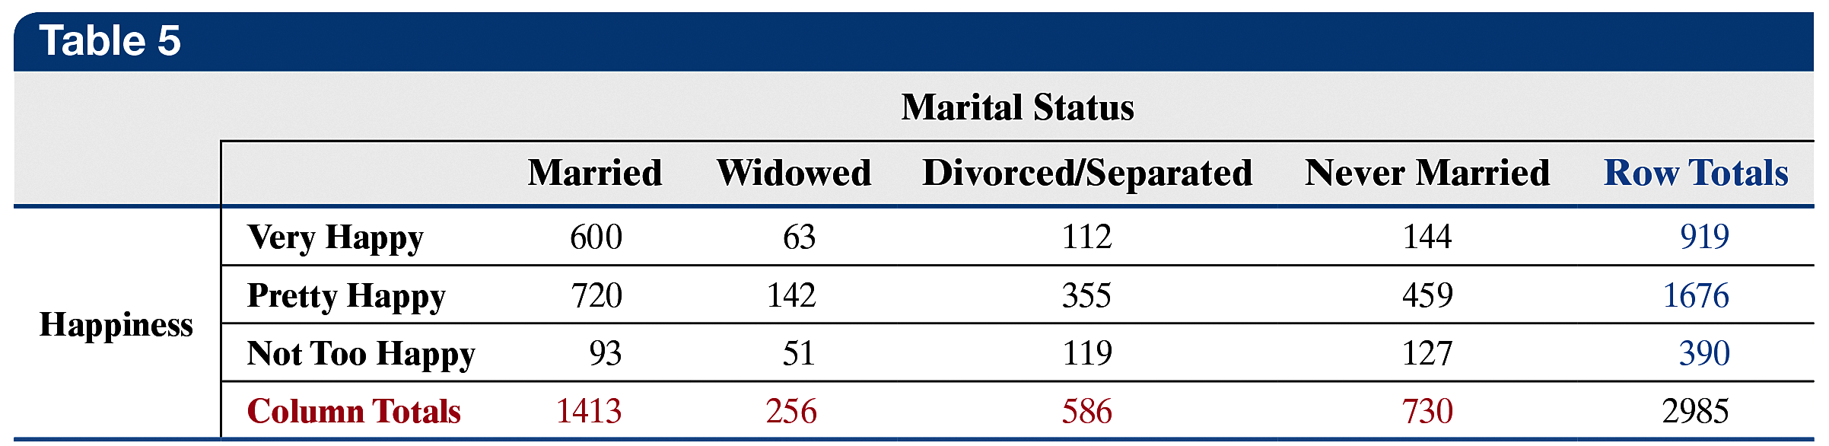
EXAMPLE Determining the Expected Counts in a
(2 of 6) Test for Independence
Step 1 The row totals (blue) and column totals (red) are presented in Table 5.
12-45

Slide 46
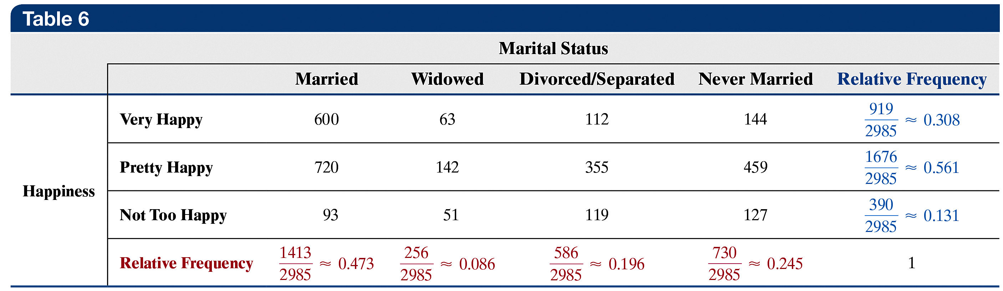
EXAMPLE Determining the Expected Counts in a
(3 of 6) Test for Independence
Step 2 The relative marginal frequencies for the row variable (happiness) and column variable (marital status) are presented in Table 6.
12-46

Slide 47
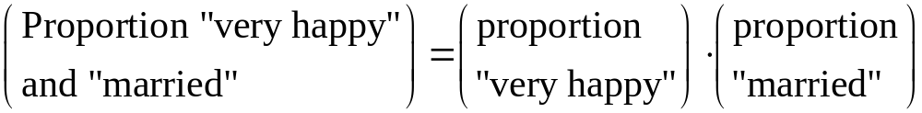
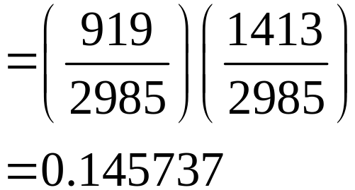
EXAMPLE Determining the Expected Counts in a
(4 of 6) Test for Independence
Step 3 Assume the variables are independent and use the Multiplication Rule for Independent Events to compute the expected proportions for each cell. For example, the proportion of individuals who are “very happy” and “married” would be
12-47

Slide 48
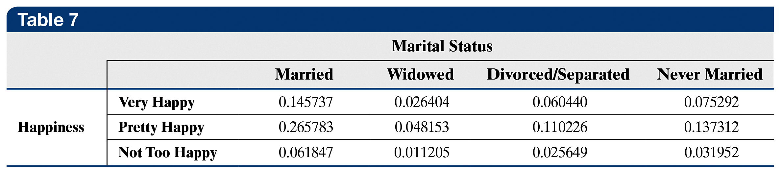
EXAMPLE Determining the Expected Counts in a
(5 of 6) Test for Independence
Table 7 shows the expected proportion in each cell, assuming independence.
12-48

Slide 49
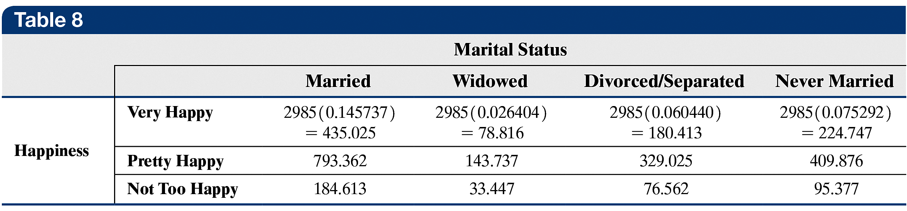
EXAMPLE Determining the Expected Counts in a
(6 of 6) Test for Independence
Step 4 Multiply the expected proportions in Table 7 by 2985, the sample size, to obtain the expected counts. See Table 8.
If happiness and marital status are independent, we would expect a random sample of 2985 individuals to contain about 435 who are “very happy” and “married.”
12-49

Slide 50
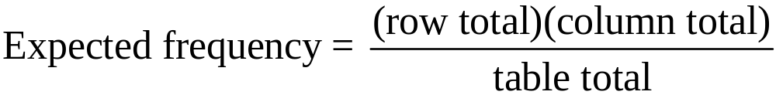
Expected Frequencies in a Chi-Square Test for Independence
To find the expected frequencies in a cell when performing a chi-square independence test, multiply the cell’s row total by its column total and divide this result by the table total. That is,
(1)
12-50

Slide 51
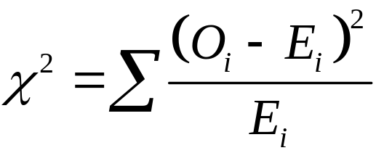
Test Statistic for the Test of Independence
Let O_{i} represent the observed number of counts in the
ith cell and E_{i} represent the expected number of counts
in the ith cell. Then
approximately follows the chi-square distribution with
(r – 1)(c – 1) degrees of freedom, where r is the number of rows and c is the number of columns in the contingency table, provided that (1) all expected frequencies are greater than or equal to 1 and (2) no more than 20% of the expected frequencies are less than 5.
12-51

Slide 52
Chi-Square Test for Independence
To test the hypothesis regarding the association between (or independence of) two variables in a contingency table, we use the steps that follow:
Step 1 Determine the null and alternative hypotheses.
H₀: The row variable and column variables
are independent.
H₁: The row variable and column variables
are dependent.
Step 2 Choose a level of significance, α, depending on the seriousness of making a Type I error.
12-52

Slide 53

Chi-Square Test for Independence
Step 3
(a) Calculate the expected frequencies (counts) for each
cell in the contingency table using Formula (1).
(b) Verify that the requirements for the chi-square test
for independence are satisfied:
1. All expected frequencies are greater than or
equal to 1
2. No more than 20% of the expected frequencies
are less than 5.
12-53

Slide 54
Chi-Square Test for Independence
Classical Approach
Step 3 (continued)
(c) Compute the test statistic
Note: O_{i} is the observed frequency for the ith cell.
12-54

Slide 55
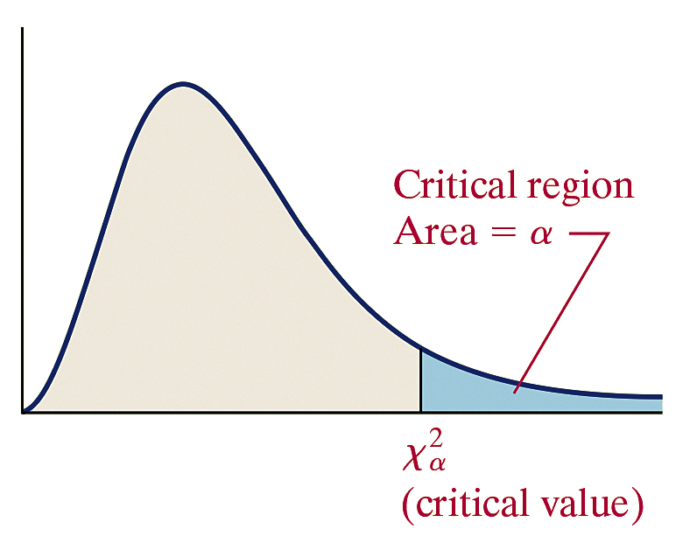
Chi-Square Test for Independence
Classical Approach
Step 4 Determine the critical value using Table VIII.
All chi-square tests for independence are right-tailed
tests, so the critical value is with (r – 1)(c – 1) degrees of freedom, where r is the
number of rows and c is the
number of columns in the
contingency table.
12-55

Slide 56
Chi-Square Test for Independence
Classical Approach
Compare the critical value to the test statistic. If
reject the null hypothesis.
Step 5 State the conclusion.
12-56

Slide 57
Chi-Square Test for Independence
P-Value Approach
Step 3 (continued)
(c) Compute the test statistic
Note: O_{i} is the observed frequency for the ith cell.
12-57

Slide 58
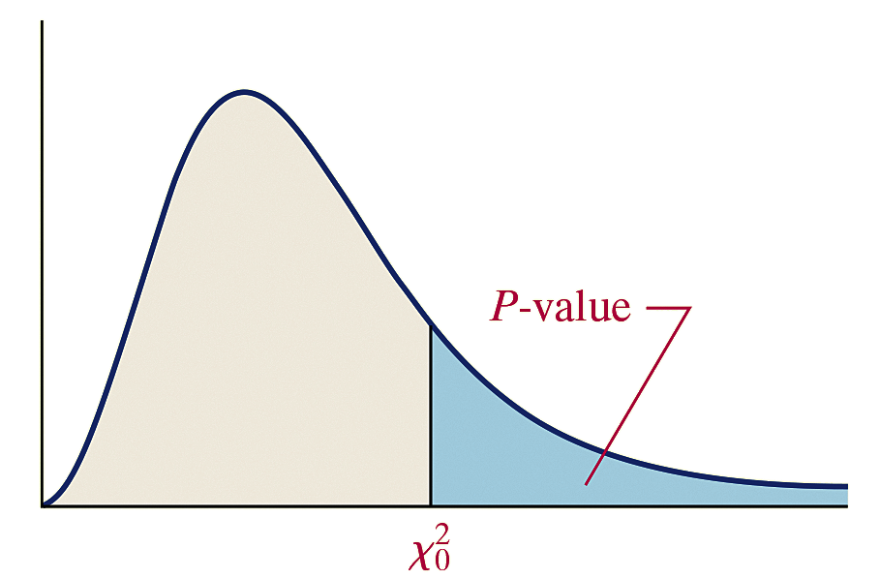
Chi-Square Test for Independence
P-Value Approach
(d) Use Table VIII to determine an approximate P-value by determining the area under the chi-square distribution with (r – 1)(c – 1) degrees of freedom to the right of the test statistic, where r is the number of rows and c is the number of columns in
the contingency table.
12-58

Slide 59
Chi-Square Test for Independence
P-Value Approach
Technology Step 3 (continued)
(c) Use a statistical spreadsheet or calculator with
statistical capabilities to obtain the P-value.
Step 4 If P-value < α, reject the null hypothesis.
Step 5 State the conclusion.
12-59

Slide 60
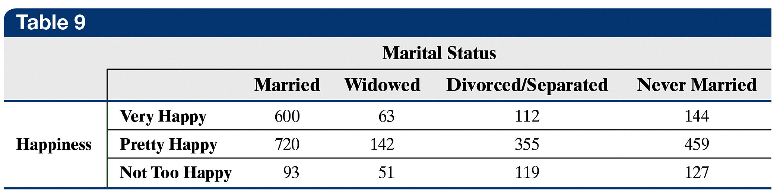
EXAMPLE Performing a Chi-Square Test for
(1 of 10) Independence
Does one’s happiness depend on one’s marital status? We present the data from a previous example in Table 9 to answer this question. Use the α = 0.05 level of significance.
12-60

Slide 61
EXAMPLE Performing a Chi-Square Test for
(2 of 10) Independence
Step 1 We want to determine whether happiness and marital status are dependent or independent. The null hypothesis is a statement of “no effect,” so we state the hypotheses as follows:
H₀: Happiness and marital status are independent (not related)
H₁: Happiness and marital status are dependent (related)
Step 2 The level of significance is α = 0.05.
12-61

Slide 62
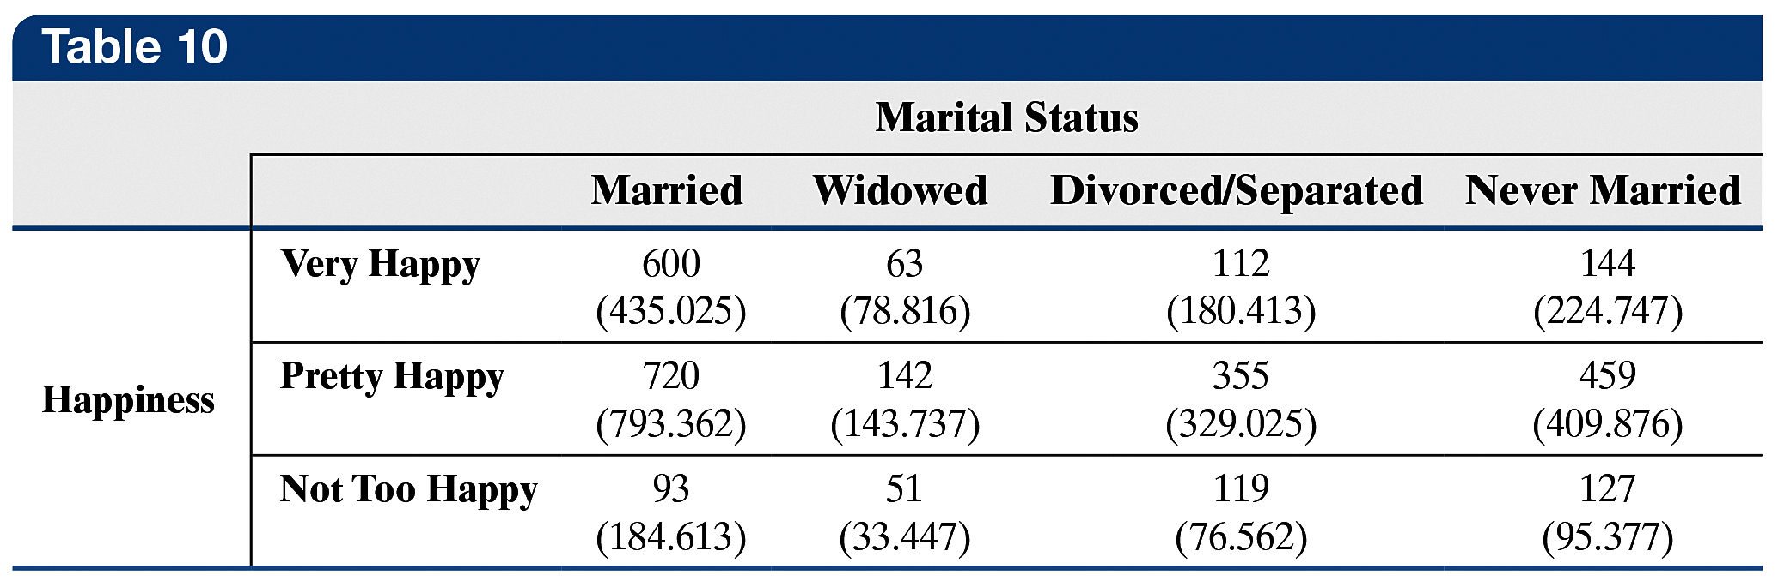
EXAMPLE Performing a Chi-Square Test for
(3 of 10) Independence
Step 3
(a) The expected frequencies were determined in a previous
example. Table 10 shows the observed frequencies, with the
expected frequencies in parentheses.
(b) Since none of the expected frequencies are less than 5, the
requirements for the goodness-of-fit test are satisfied.
12-62

Slide 63
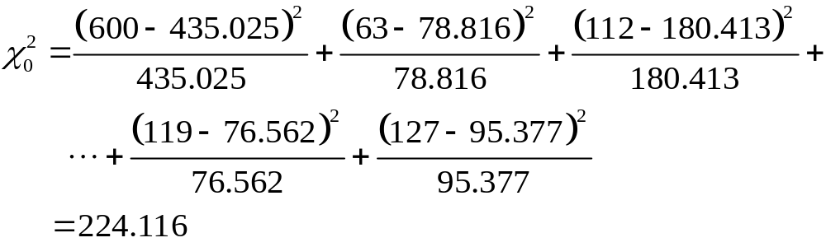
EXAMPLE Performing a Chi-Square Test for
(4 of 10) Independence
Classical Approach
Step 3 (continued)
(c)
12-63

Slide 64

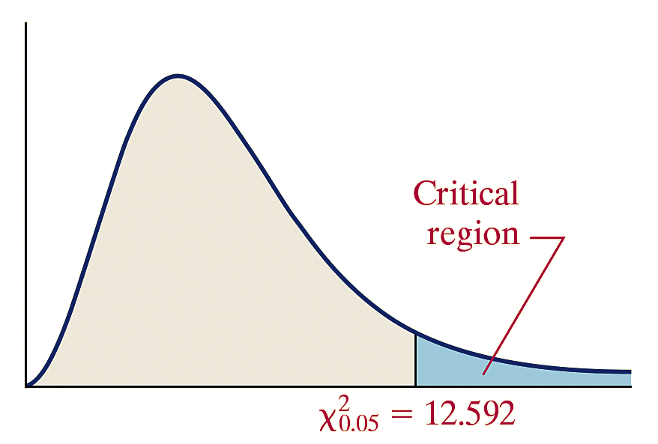

EXAMPLE Performing a Chi-Square Test for
(5 of 10) Independence
Classical Approach
Step 4 There are r = 3 rows and c = 4 columns. The critical value is using (r – 1)(c – 1) = (3 – 1)(4 – 1) = 6 degrees of freedom.
Because the test statistic, 224.116, is greater than the critical value, we reject the null hypothesis.
12-64

Slide 65
EXAMPLE Performing a Chi-Square Test for
(6 of 10) Independence
Classical Approach
Step 5 The data suggest there is sufficient evidence, at the
α = 0.05 level of significance, to conclude that happiness and marital status are dependent. We conclude that happiness and marital status are associated with each other.
12-65

Slide 66
EXAMPLE Performing a Chi-Square Test for
(7 of 10) Independence
P-Value Approach
By Hand Step 3 (continued)
(c)
12-66

Slide 67

EXAMPLE Performing a Chi-Square Test for
(8 of 10) Independence
P-Value Approach
(d) There are r = 3 rows and c = 4 columns, so we find the P-value using (r – 1)(c – 1) = (3 – 1)(4 – 1) = 6 degrees of freedom. The P-value is the area under the chi-square distribution with 6 degrees of freedom to the right of
Using Table VIII, we find the row that corresponds to 6 degrees of freedom. The value of 224.116 is greater than 18.548. The area under the chi-square distribution to the right of 18.548 is 0.005. Because 224.116 is greater than 18.548, the P-value is less than 0.005, so we have P-value < 0.005.
12-67

Slide 68

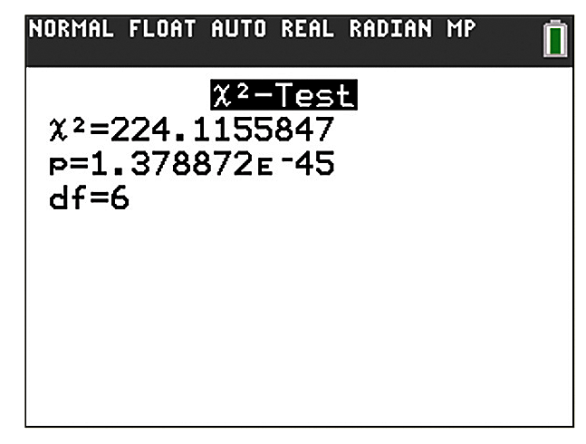
EXAMPLE Performing a Chi-Square Test for
(9 of 10) Independence
P-Value Approach
Technology Step 3 (continued)
(c) The figure shows the P-value obtained from a TI-84 Plus C
graphing calculator using the Calculate feature. The P-value
is reported as which is very close to 0.
12-68

Slide 69
EXAMPLE Performing a Chi-Square Test for
(10 of 10) Independence
P-Value Approach
Step 4 Because the P-value is less than the level of significance, we reject the null hypothesis.
Step 5 The data suggest there is sufficient evidence, at the
α = 0.05 level of significance, to conclude that happiness and marital status are dependent. We conclude that happiness and marital status are associated with each other.
12-69

Slide 70
To see the association between happiness and marital status, draw a bar graph of the conditional distribution of happiness by marital status. Recall that a conditional distribution lists the relative frequency of each category of a variable, given a specific value of the other variable in a contingency table.
12-70

Slide 71
EXAMPLE Constructing a Conditional Distribution
(1 of 6) and Bar Graph
Find the conditional distribution of happiness by marital status for the data in Table 9. Then draw a bar graph that represents the conditional distribution of happiness by marital status.
12-71

Slide 72



EXAMPLE Constructing a Conditional Distribution
(2 of 6) and Bar Graph
Start with the individuals who are “married.” The relative frequency with which we observe an individual who is “very happy,” given that the individual is “married,” is
The relative frequency with which we observe an individual who is “pretty happy,” given that the individual is “married,” is
The relative frequency with which we observe an individual who is “not too happy,” given that the individual is “married,” is
12-72

Slide 73



EXAMPLE Constructing a Conditional Distribution
(3 of 6) and Bar Graph
Now compute the relative frequency for each level of happiness, given that the individual is “widowed.” The relative frequency with which we observe an individual who is “very happy,” given that the individual is “widowed,” is
The relative frequency with which we observe an individual who is “pretty happy,” given that the individual is “widowed,” is
The relative frequency with which we observe an individual who is “not too happy,” given that the individual is “widowed,” is
12-73

Slide 74
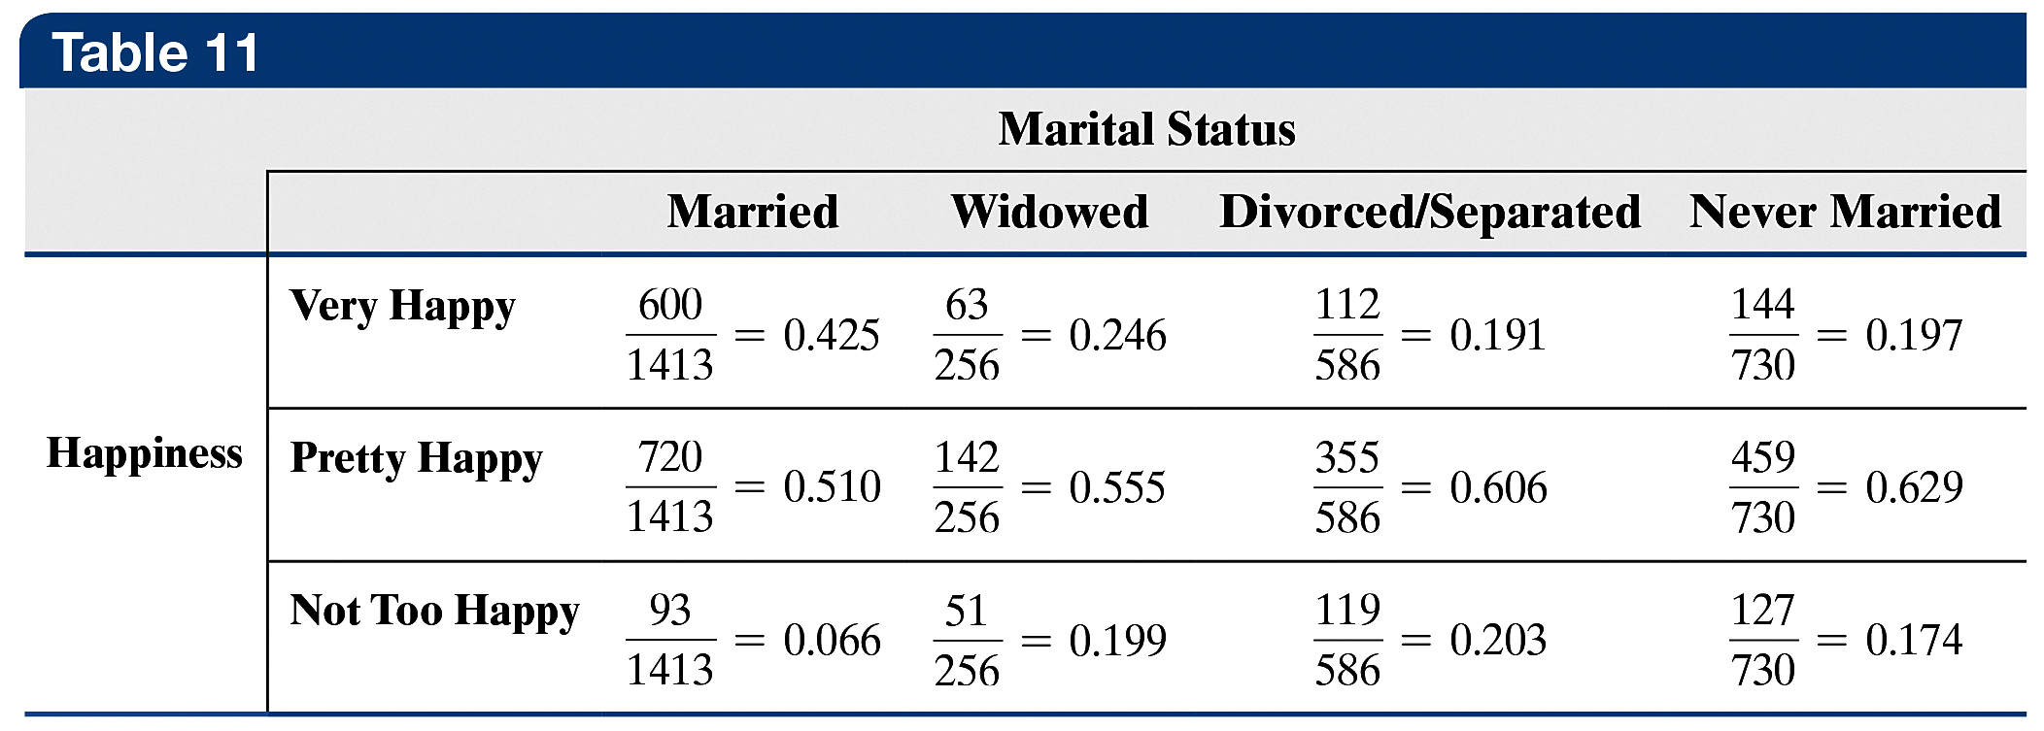
EXAMPLE Constructing a Conditional Distribution
(4 of 6) and Bar Graph
We repeat the process for “divorced/separated” and “never married” and obtain Table 11.
12-74

Slide 75
EXAMPLE Constructing a Conditional Distribution
(5 of 6) and Bar Graph
From the conditional distribution by marital status, the association between happiness and marital status should be apparent. The proportion of individuals who are “very happy” is highest in the “married” category. In addition, the proportion of individuals who are “not too happy” is lowest in the “married” category.
The figure on the next slide shows the graph of the conditional distribution. The blue bars represent the proportion of individuals who are “Very Happy” for each marital status, the green bars represent the proportion of individuals who are “Pretty Happy” for each marital status, and the orange bars represent the proportion of individuals who are “Not Too Happy” for each marital status.
12-75

Slide 76
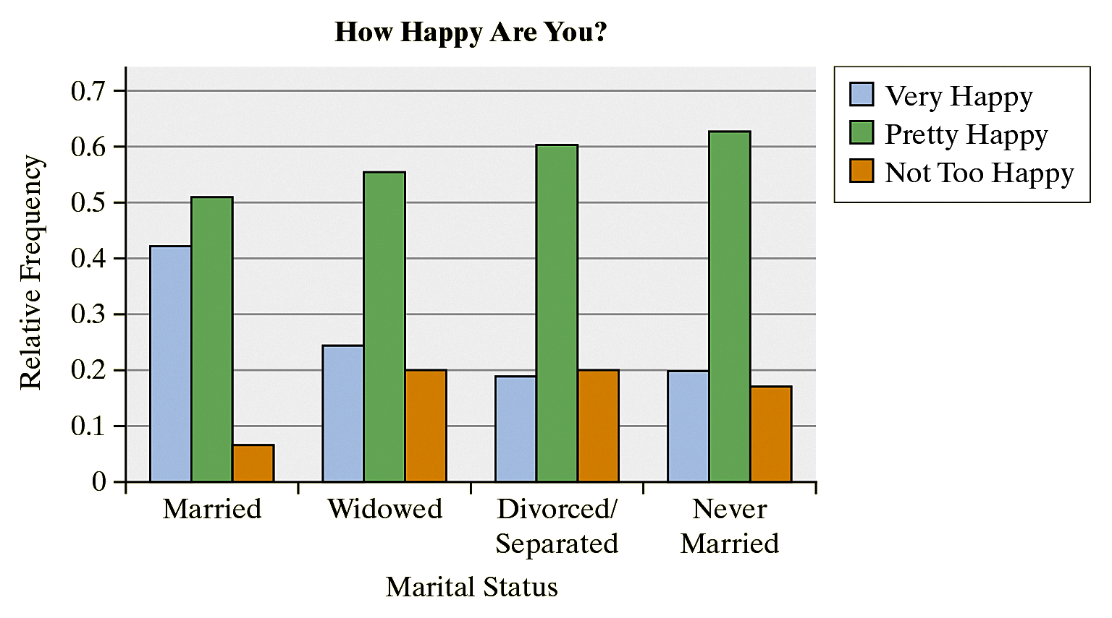
EXAMPLE Constructing a Conditional Distribution
(6 of 6) and Bar Graph
From the bar graph, it is clear that a higher proportion of married individuals are “very happy” compared with the other categories of marital status.
12-76

Slide 77
Objective 2
Perform a Test for Homogeneity of Proportions
12-77

Slide 78
In a chi-square test for homogeneity of proportions, we test whether different populations have the same proportion of individuals with some characteristic.
12-78

Slide 79
The procedures for performing a test of homogeneity are identical to those for a test of independence.
12-79

Slide 80
EXAMPLE A Test for Homogeneity of Proportions
(1 of 13)
Zocor is a drug manufactured by Merck and Co. that is meant to reduce the level of LDL (bad) cholesterol and increase the level of HDL (good) cholesterol. In clinical trials of the drug, patients were randomly divided into three groups. Group 1 received Zocor; group 2 received a placebo; group 3 received cholestyramine, a cholesterol-lowering drug that is currently available. Table 12 on the next slide contains the number of patients in each group who did and did not experience abdominal pain as a side effect.
Is there evidence to indicate that the proportion of subjects in each group who experienced abdominal pain is different at the α = 0.01 level of significance?
12-80

Slide 81
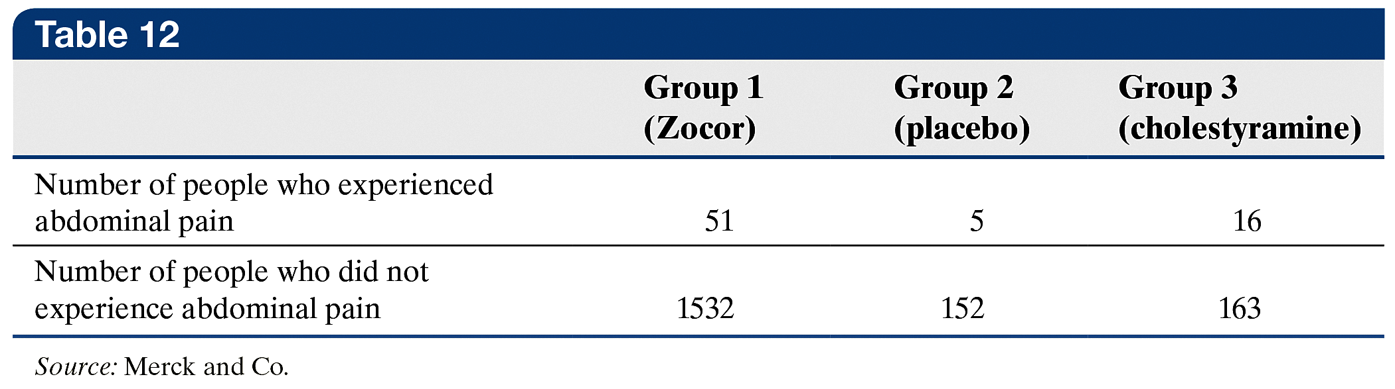
EXAMPLE A Test for Homogeneity of Proportions
(2 of 13)
Step 1 The null hypothesis is a statement of “no difference,” so the proportion of subjects in each group who experienced abdominal pain are equal. We state the hypotheses as follows:
H₀: p₁ = p₂ = p₃
H₁: At least one of the proportions is different from the others.
Here, p₁, p₂, and p₃ are the proportions in groups 1, 2, and 3, respectively.
12-81

Slide 82
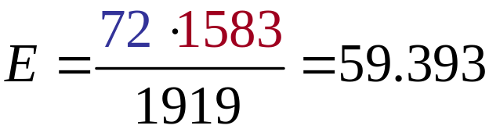
EXAMPLE A Test for Homogeneity of Proportions
(3 of 13)
Step 2 The level of significance is α = 0.01.
Step 3
(a) The expected frequency of subjects who experienced
abdominal pain in group 1 is the product of the row total of
individuals who experienced abdominal pain and the
column total of individuals in group 1, divided by the total
number of subjects in the study. So
Table 13 on the next slide contains the row and column totals, the observed frequencies, and the expected frequencies (in parentheses).
12-82

Slide 83
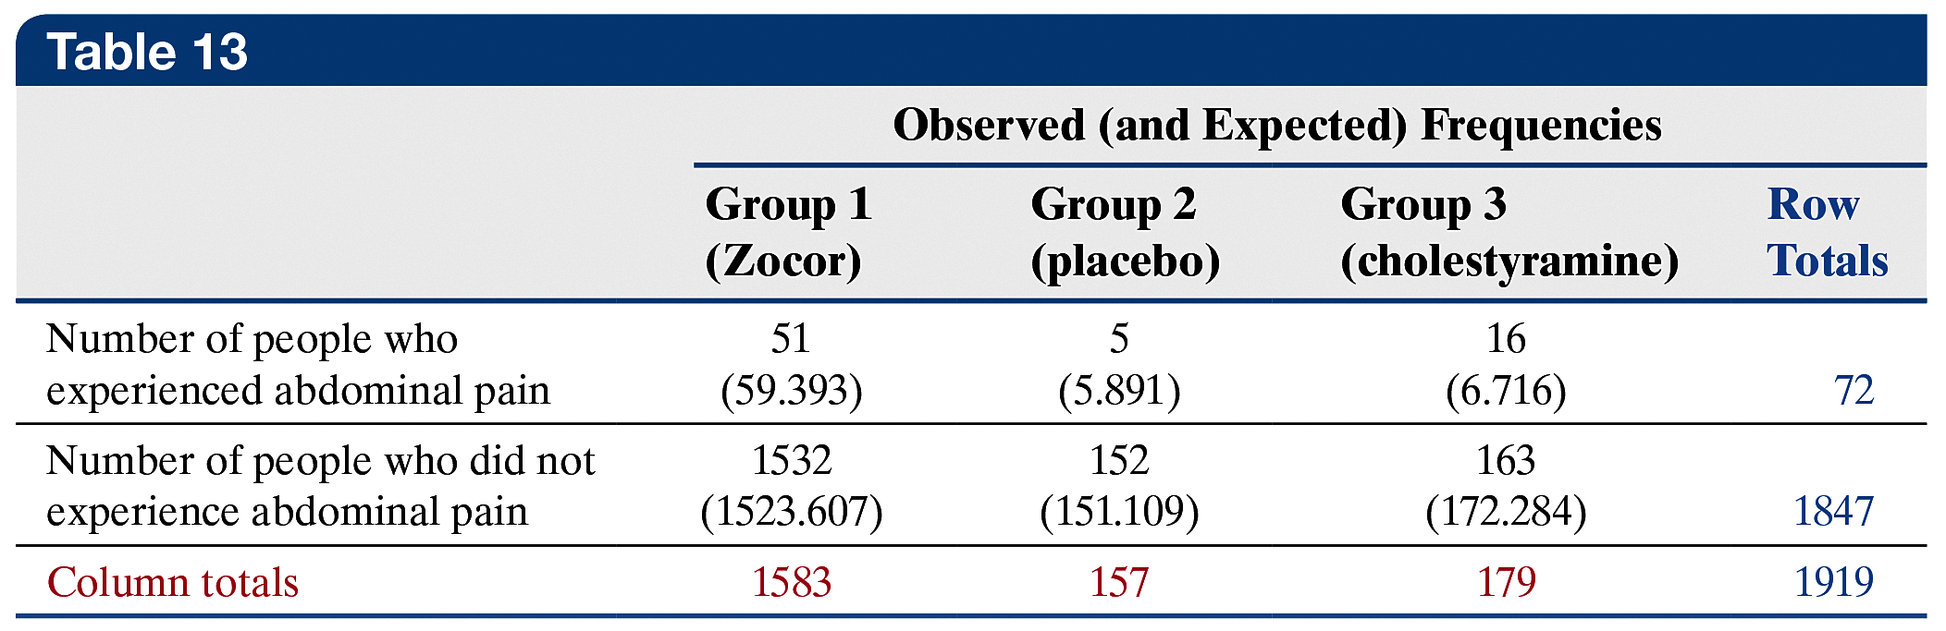
EXAMPLE A Test for Homogeneity of Proportions
(4 of 13)
(b) Since none of the expected frequencies are less than 5, the
requirements for the test of homogeneity of proportions are
satisfied.
12-83

Slide 84
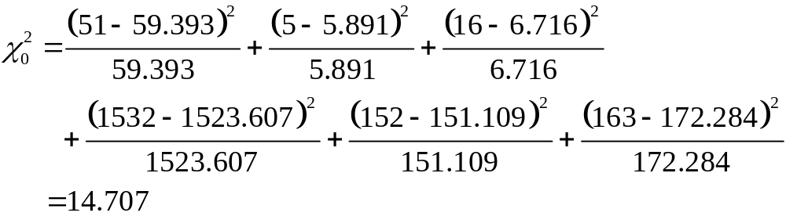
EXAMPLE A Test for Homogeneity of Proportions
(5 of 13)
Classical Approach
Step 3 (continued)
(c) The test statistic is
12-84

Slide 85

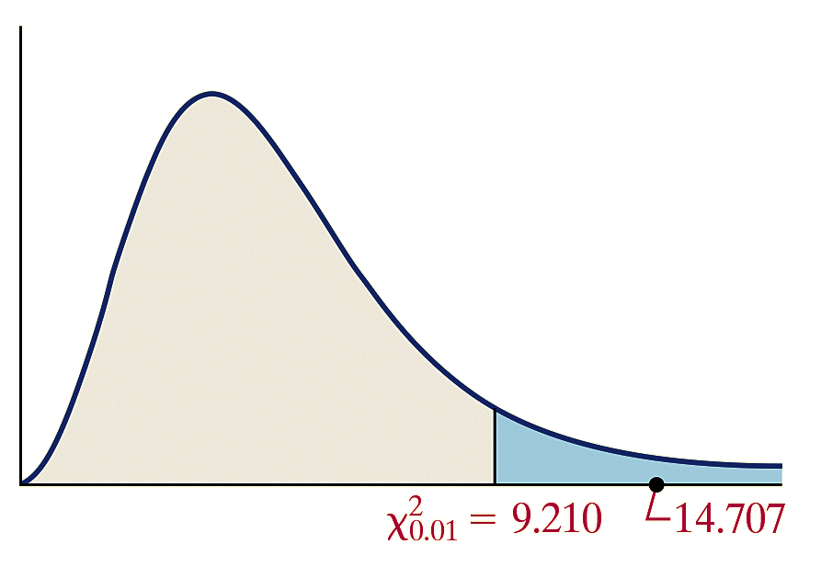
EXAMPLE A Test for Homogeneity of Proportions
(6 of 13)
Classical Approach
Step 4 There are r = 2 rows and c = 3 columns, so we
find the critical value using (2 – 1)(3 – 1) = 2 degrees of
freedom. The critical value is
Because the test statistic, 14.707, is greater than the critical value, 9.210, we reject the null hypothesis.
12-85

Slide 86
EXAMPLE A Test for Homogeneity of Proportions
(7 of 13)
Classical Approach
Step 5 The data suggest that there is sufficient evidence at the
α = 0.01 level of significance to reject the null hypothesis that the proportion of subjects in each group who experience abdominal pain are equal. We conclude that at least one of the three groups experiences abdominal pain at a rate that is different from the other two groups.
The figure on the next slide shows the conditional bar graph by treatment. From the graph, it is apparent that a higher proportion of patients taking cholestyramine experience abdominal pain as a side effect.
12-86

Slide 87
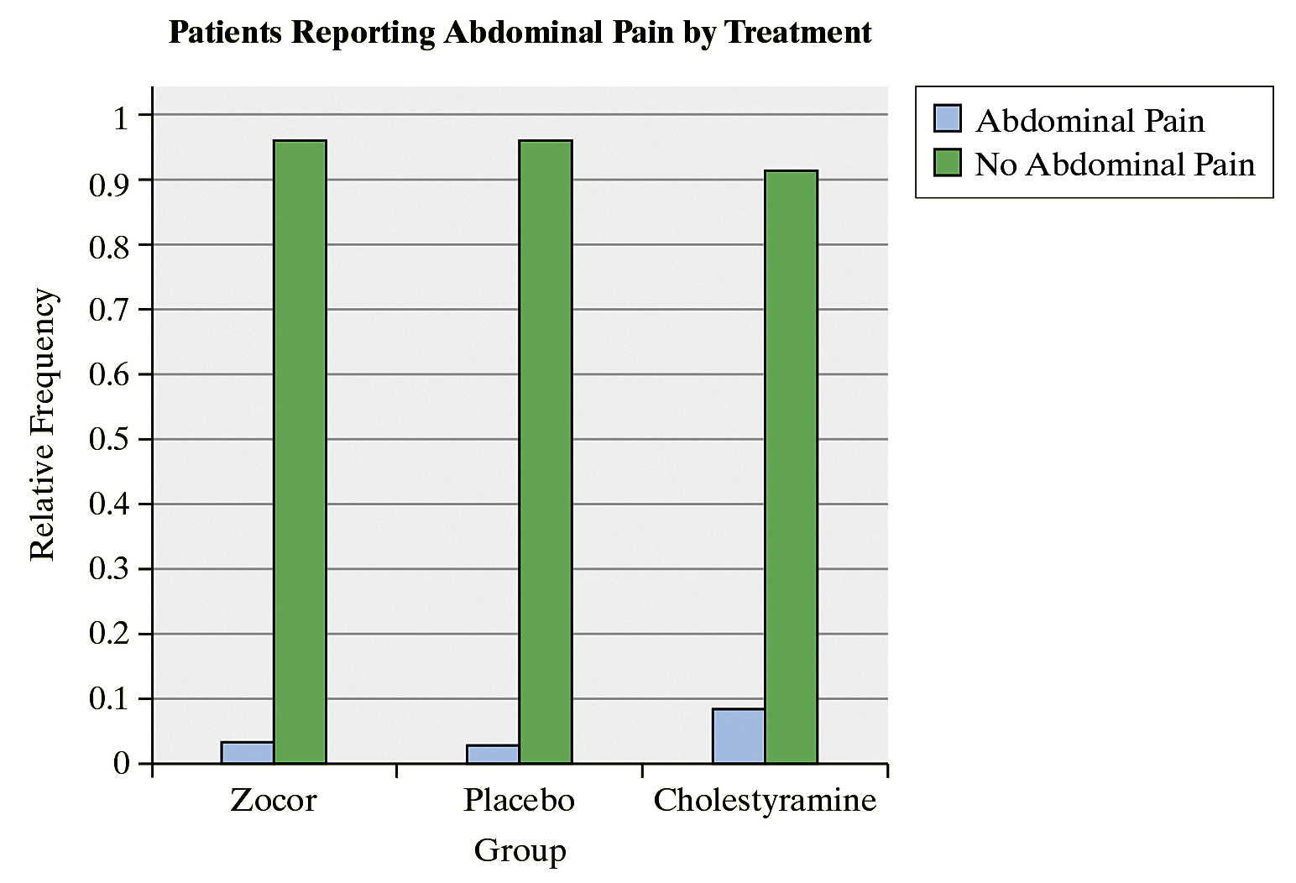
EXAMPLE A Test for Homogeneity of Proportions
(8 of 13)
Classical Approach
12-87

Slide 88
EXAMPLE A Test for Homogeneity of Proportions
(9 of 13)
P-Value Approach
By Hand Step 3 (continued)
(c) The test statistic is
12-88

Slide 89
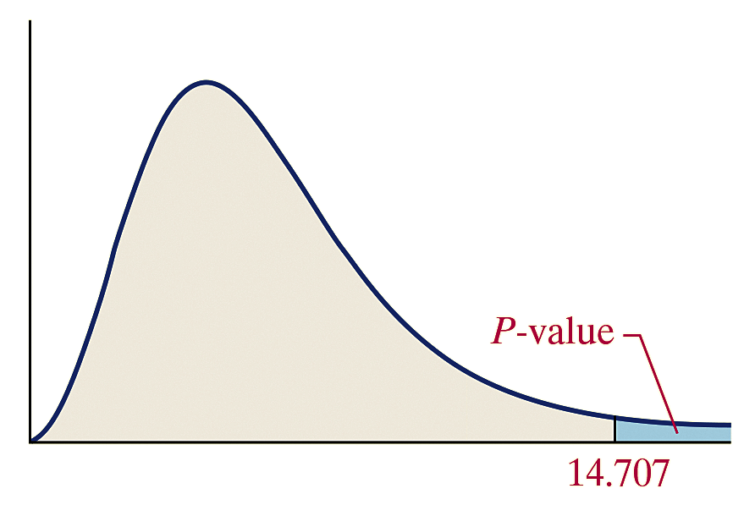

EXAMPLE A Test for Homogeneity of Proportions
(10 of 13)
P-Value Approach
(c) There are r = 2 rows and
c = 3 columns, so we find the
P-value using (2 – 1)(3 – 1) = 2
degrees of freedom. The
P-value is the area under the
chi-square distribution with 2
degrees of freedom to the right of
Using Table VIII, in the row corresponding to 2 degrees of freedom, the area under the chi-square distribution with 2 degrees of freedom, to the right of 10.597, is 0.005. Because 14.707 is greater than 10.597, the P-value is less than 0.005.
So P-value < 0.005.
12-89

Slide 90
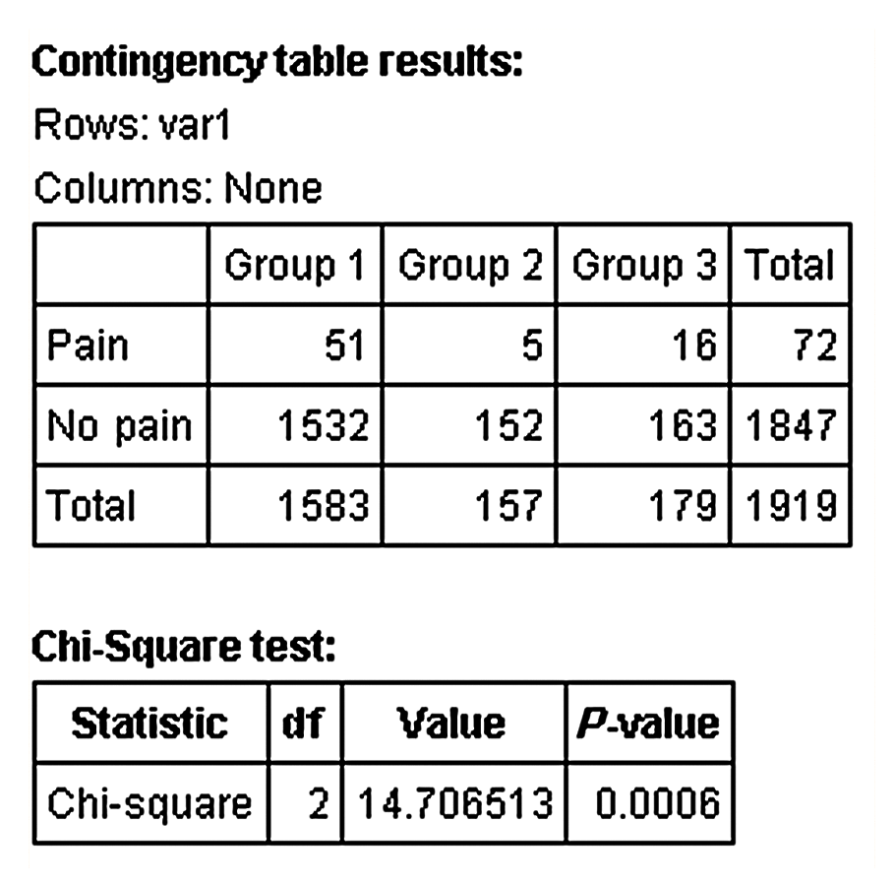
EXAMPLE A Test for Homogeneity of Proportions
(11 of 13)
P-Value Approach
Technology Step 3 (continued)
(c) The figure shows the P-value
obtained from StatCrunch.
The P-value is reported as
0.0006.
Step 4 Because the P-value is less than the level of significance, α = 0.01, we reject the null hypothesis.
12-90

Slide 91
EXAMPLE A Test for Homogeneity of Proportions
(12 of 13)
P-Value Approach
Step 5 The data suggest that there is sufficient evidence at the
α = 0.01 level of significance to reject the null hypothesis that the proportion of subjects in each group who experience abdominal pain are equal. We conclude that at least one of the three groups experiences abdominal pain at a rate that is different from the other two groups.
The figure on the next slide shows the conditional bar graph by treatment. From the graph, it is apparent that a higher proportion of patients taking cholestyramine experience abdominal pain as a side effect.
12-91

Slide 92
EXAMPLE A Test for Homogeneity of Proportions
(13 of 13)
P-Value Approach
12-92

Slide 93
If Model Requirements Fail
Recall that the requirements for performing a chi-square test are that all expected frequencies are greater than 1 and that at most 20% of the expected frequencies can be less than 5. If these requirements are not satisfied, the researcher has one of two options:
(1) combine two or more columns (or rows) to increase
the expected frequencies or
(2) increase the sample size.
12-93

Slide 94
12.3 Inference about Two
Population Proportions:
Dependent Samples
Learning Objectives
Test Hypotheses Regarding Two Proportions from Dependent Samples
12-94

Slide 95
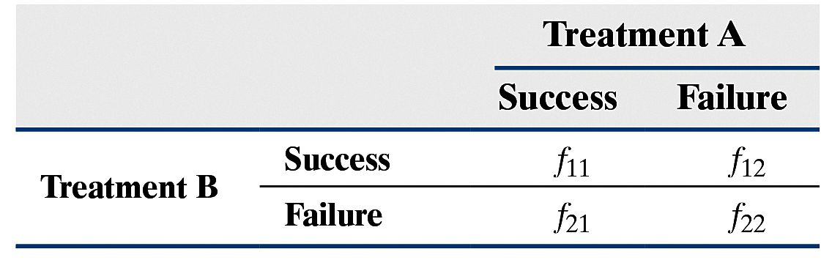
Testing A Hypothesis Regarding the Difference of Two Proportions: Dependent Samples
To test hypotheses regarding two population proportions, p₁ and p₂, where the samples are dependent, arrange the data in a contingency table
as follows:
12-95

Slide 96


Testing A Hypothesis Regarding the Difference of Two Proportions: Dependent Samples
We can use the steps that follow provided that
1. The samples are dependent and are obtained randomly.
2. The total number of observations where the outcomes differ are greater than or equal to 10. That is,
Step 1 Determine the null and alternative hypotheses.
H₀: the proportions between the two populations are
equal (p₁ = p₂)
H₁: the proportions between the two populations
differ
12-96

Slide 97
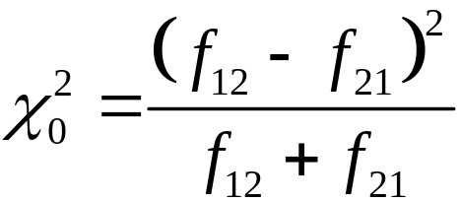
Testing A Hypothesis Regarding the Difference of Two Proportions: Dependent Samples
Step 2 Select a level of significance, α, depending on the seriousness of making a Type I error.
Step 3 Compute the test statistic
12-97

Slide 98
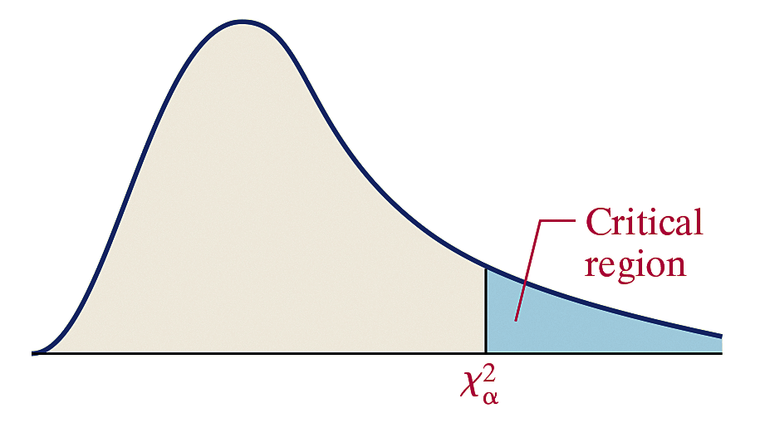
Testing A Hypothesis Regarding the Difference of Two Proportions: Dependent Samples
Classical Approach
Step 3 (continued) Use Table VIII to determine the
critical value with 1 degree of freedom.
12-98

Slide 99

Testing A Hypothesis Regarding the Difference of Two Proportions: Dependent Samples
Classical Approach
Step 4 If reject the null hypothesis.
Step 5 State the conclusion.
12-99

Slide 100
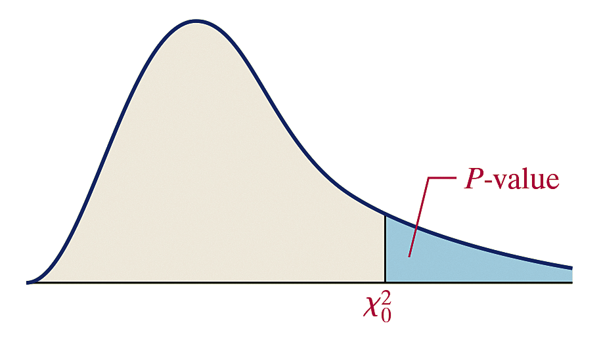
Testing A Hypothesis Regarding the Difference of Two Proportions: Dependent Samples
P-Value Approach
By Hand Step 3 (continued) Use Table VIII to determine
the P-value by determining the area under the chi-square
distribution with 1 degree of freedom to the right of the test statistic.
12-100

Slide 101
Testing A Hypothesis Regarding the Difference of Two Proportions: Dependent Samples
P-Value Approach
Technology Step 3 (continued) Use a statistical spreadsheet or calculator with statistical capabilities to obtain the P-value.
Step 4 If the P-value < α, reject the null hypothesis.
Step 5 State the conclusion.
12-101

Slide 102
EXAMPLE Analyzing the Difference of Two
(1 of 7) Proportions from Matched-Pairs Data
A recent General Social Survey asked the following two questions of a random sample of 1492 adult Americans under the hypothetical scenario that the government suspected that a terrorist act was about to happen:
Do you believe that the authorities should have the right to tap people’s telephone conversations?
Do you believe that the authorities should have the right to stop and search people on the street at random?
12-102

Slide 103
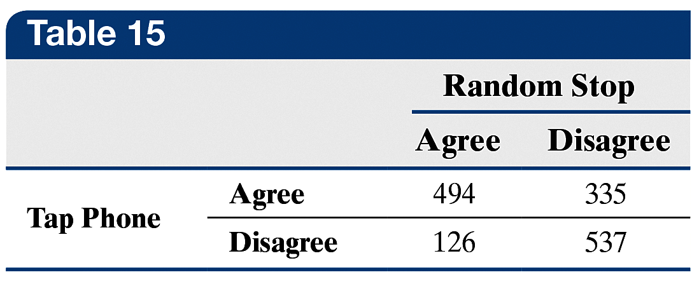
EXAMPLE Analyzing the Difference of Two
(2 of 7) Proportions from Matched-Pairs Data
The results of the survey are shown in Table 15.
Do the proportion of people who agree with each scenario differ significantly? Use the α = 0.05 level of significance.
12-103

Slide 104

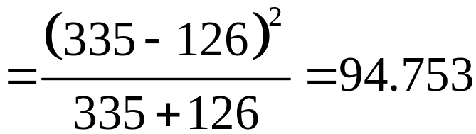
EXAMPLE Analyzing the Difference of Two
(3 of 7) Proportions from Matched-Pairs Data
Step 1 The hypotheses are as follows:
H₀: the proportions between the two populations are
equal (p_{T} = p_{R})
H₁: the proportions between the two populations differ
Step 2 The level of significance is α = 0.05.
Step 3 The test statistic is
12-104

Slide 105



EXAMPLE Analyzing the Difference of Two
(4 of 7) Proportions from Matched-Pairs Data
Classical Approach
Step 3 (continued) The critical value with an α = 0.05 level of significance with 1 degree of freedom is
The critical region is displayed in the figure.
Step 4 Because (the test statistic lies in the critical region), we reject the null hypothesis.
12-105

Slide 106
EXAMPLE Analyzing the Difference of Two
(5 of 7) Proportions from Matched-Pairs Data
Classical Approach
Step 5 There is sufficient evidence to conclude that there is a difference in the proportion of adult Americans who believe it is okay to phone tap versus stopping and searching people on the street in the event that the government believed a terrorist
plot was about to happen. In fact, looking at the sample proportions, it seems clear that more people are willing to allow phone tapping than they are to allow stopping and searching on the street.
12-106

Slide 107


EXAMPLE Analyzing the Difference of Two
(6 of 7) Proportions from Matched-Pairs Data
P-Value Approach
By Hand Step 3 (continued) The P-value is the area under the
chi-square distribution to the right of the test statistic,
The test statistic is so large that the P-value < 0.005.
Technology Step 3 (continued)
The figure shows the P-value
obtained from StatCrunch.
The P-value is reported
as < 0.0001.
12-107

Slide 108
EXAMPLE Analyzing the Difference of Two
(7 of 7) Proportions from Matched-Pairs Data
P-Value Approach
Step 4 Because P-value < α, we reject the null hypothesis.
Step 5 There is sufficient evidence to conclude that there is a difference in the proportion of adult Americans who believe it is okay to phone tap versus stopping and searching people on the street in the event that the government believed a terrorist
plot was about to happen. In fact, looking at the sample proportions, it seems clear that more people are willing to allow phone tapping than they are to allow stopping and searching on the street.
12-108

